Slide 1
Introduction to eSight 21.0 Server Service Management
Security Level:

Slide 2
Features
Routine O&M

Slide 3
OS Deployment
Scenario: Applicable to in-band OS installation during site deployment and O&M. Mainstream OSs are supported.
Key features:
Image file management: manages OS images in the system, provides the functions of adding, deleting, modifying, and querying OS images, and allows you to view the image space usage.
1
OS deployment template management: manages deployment templates in the system and provides the functions of adding, deleting, modifying, and querying templates.
The template supports common parameters, such as the root user name and password, OS language, keyboard type, time zone, and installation location partition. You can choose whether to deploy the iBMA.
2
3
Deployment execution: After devices to be deployed are added to the OS deployment template, a deployment task can be delivered.
The deployment task supports differentiated configurations for devices (host name).
Specifications: Each task supports a maximum of 200 devices and concurrent deployment of 40 devices. Currently, only servers with SPs are supported. V3 servers are not supported.
Creating an image template
Creating an OS deployment template
Deploying an OS
Other operations
Modify and delete
Common standard images are supported. You are advised to perform integrity verification locally before uploading images.
Ensure that the image class and version number are correct. Otherwise, the installation will fail.
A deployment template is used to collect user deployment information. The information varies depending on the image class.
Installation by user-defined partition is supported.
The current system disk will be formatted during deployment. Ensure that no important data is stored on the hard disk where the OS is to be installed.
The timeout interval for deployment is 2 hours.
Constraint: The deployment template and image information cannot be deleted or modified during the deployment. You can delete or modify them only after the deployment is complete.

Slide 4
Firmware Upgrade
Scenario: Applicable to device version maintenance during O&M (firmware and driver upgrade supported)
Key features:
Upgrade package management: enables you to upload upgrade packages, interconnect with HOUP to download Huawei baselines, and create custom baselines based on the upgrade packages. In this way, you can quickly obtain required upgrade packages through baseline management.
Device version management: displays the version information about all components of managed devices and provides the function of making firmware take effect.
Upgrade schedule management: allows you to select a device and firmware packages to be upgraded, configure the upgrade policy (including the upgrade time, effective policy, and batch policy), and create an upgrade schedule.
Periodic schedule: allows you to select a group and a custom baseline to create a periodic schedule. After a device that meet the grouping conditions is managed, the device can be automatically upgraded to the specified version.
Batch upgrade: upgrades devices in batches. The next batch can be upgraded only after the first batch is successfully upgraded.
1
2
3
Specifications: Currently, a maximum of 100 devices can be deployed concurrently, and a maximum of 1000 devices can be selected for an upgrade schedule.
Selecting a device
Selecting an update package or baseline
Generating a version mapping report
Configuring an upgrade policy
Creating an upgrade schedule
Select the managed devices to be upgraded. A maximum of 1000 devices can be selected.
You can create groups and select devices by group.
Download a firmware package from the support website and upload it to the system.
You can create a baseline for multiple upgrade packages as required for quick selection during the upgrade.
You can configure the HOUP address to connect to HOUP and automatically download Huawei baselines.
The backend generates a report based on the mapping between the upgrade package and the device.
Components that can be upgraded are automatically selected based on upgrade risks and compatibility policies.
Set the upgrade time to immediate upgrade, scheduled upgrade, or periodic upgrade.
Configure policies: take effect immediately or take effect later.
You can upgrade devices in batches.
After an upgrade schedule is created, you can view the upgrade execution task in the task center. The upgrade procedure is described in the task details.

Slide 5
Profile Configuration Deployment - Server Configuration
Scenario: Configurations of a device are saved in a profile for batch configuration. The profile can be imported, exported, and quickly copied to other devices.
Key features:
Server configuration models: enables you to view the existing server models and modify the detailed information about a device model to match the device to be planned. This improves planning and management efficiency.
Server profile: enables you to configure the BIOS, RAID, and BMC parameters for devices. After a profile is applied to devices, the devices will be configured based on the parameters.
1
2
Specifications: Currently, a single profile can be bound to a maximum of 2000 devices. A maximum of 1000 devices can be selected at a time for applying a profile.
Creating a profile
Binding a server
Applying the profile
Other operations
Importing or exporting the profile
Editing or deleting the profile
Select a server model (a combination of the server model, NIC, and RAID controller card).
Select the configuration items based on site requirements, including BIOS, RAID, BMC, NIC, and PCIe topology.
Generate a profile.
Select a server to be bound.
Click Bind. The system automatically matches the servers that have the same model as the profile and have not been bound.
Select and bind a server.
Select a server to be configured.
Select an effective mode. If you select a policy that makes the configuration take effect immediately, the server may be reset during the configuration. Ensure that resetting the server does not affect services.
View the task until the task is complete.
Scenario: This function is used to back up the current profile.
If the profile is faulty, you can import it again.
Click Edit or Delete.
Modify or delete the profile.
Constraint: The delete operation can be performed only when no server is bound to it.
The modify operation can be performed only when it is not applied to the server.

Slide 6
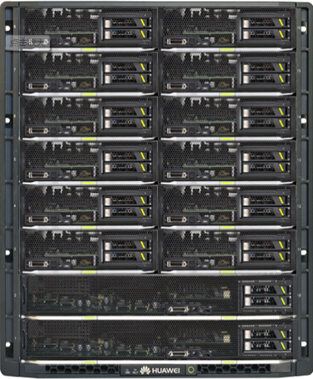
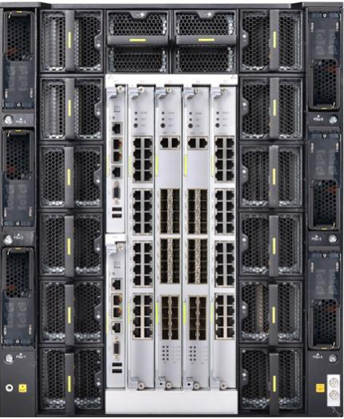
Profile Configuration Deployment - Chassis Configuration
Scenario: Configure the MM920 or MM921 chassis.
Key features:
Configuration of the entire chassis: The slots of blade servers in a chassis are bound to the server profile. You can apply configurations as a whole, create, modify, or copy a chassis profile, and bind or unbind a chassis from the chassis profile.
Graphical network configuration in the chassis: Service flows are abstracted into networks in the chassis from the service configuration perspective. You can easily complete network configuration on the graphical user interface (GUI) without caring about the complex connections in the chassis and switch module configuration commands. It would be 'what you see is what you get.' for network management.
A chassis profile can be bound to only one physical chassis.
Physical chassis
1
Binding a chassis
Blade slot and server profile
binding configuration
Switch module model configuration
Resource pool configuration
2
Blade slot
Slot number of the switch module
Network connection
Chassis profiles
CX320
CX320
CX320
CX320
MAC pool
WWN pool
Fan power
configuration
Binding blade server slots
BIOS configuration
BIOS configuration
BIOS configuration
3
Server profiles
RAID configuration
RAID configuration
RAID configuration
...
NIC configuration
NIC configuration
NIC configuration
...
...
...
Server profile A
Server profile B
Server profile N

Slide 7
Features
Routine O&M

Slide 8
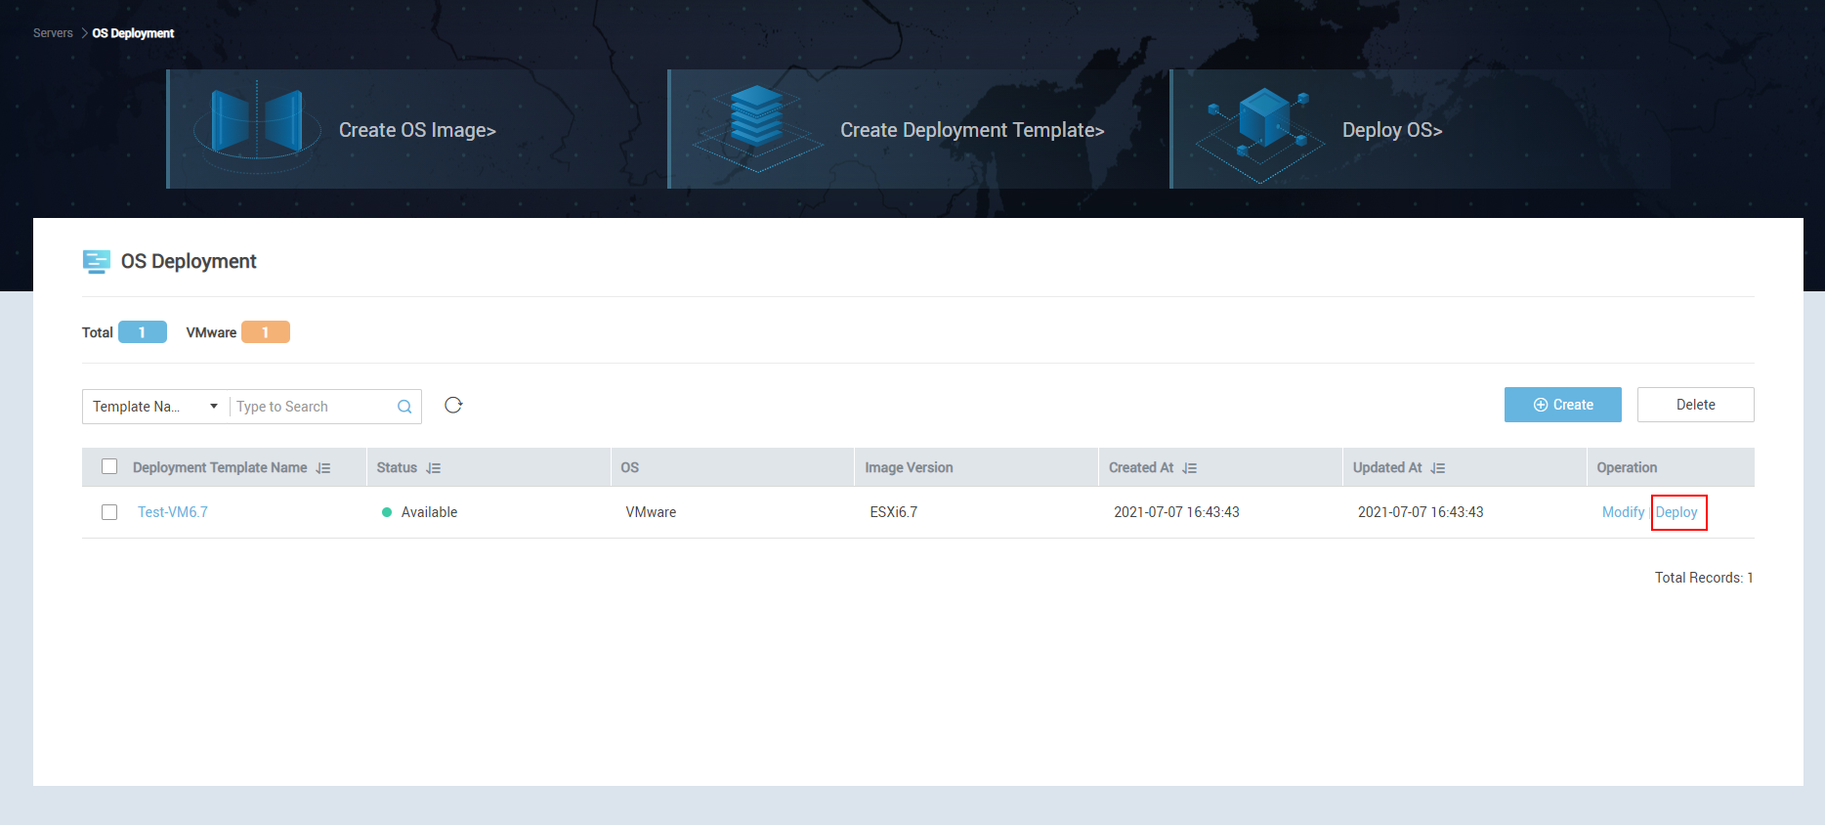
OS Deployment

Slide 9
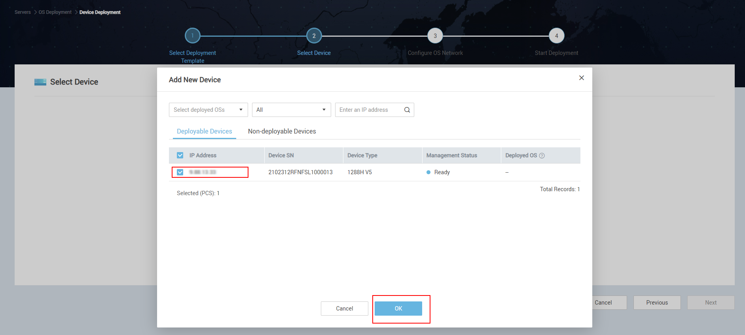
OS Deployment - Selecting a Device

Slide 10
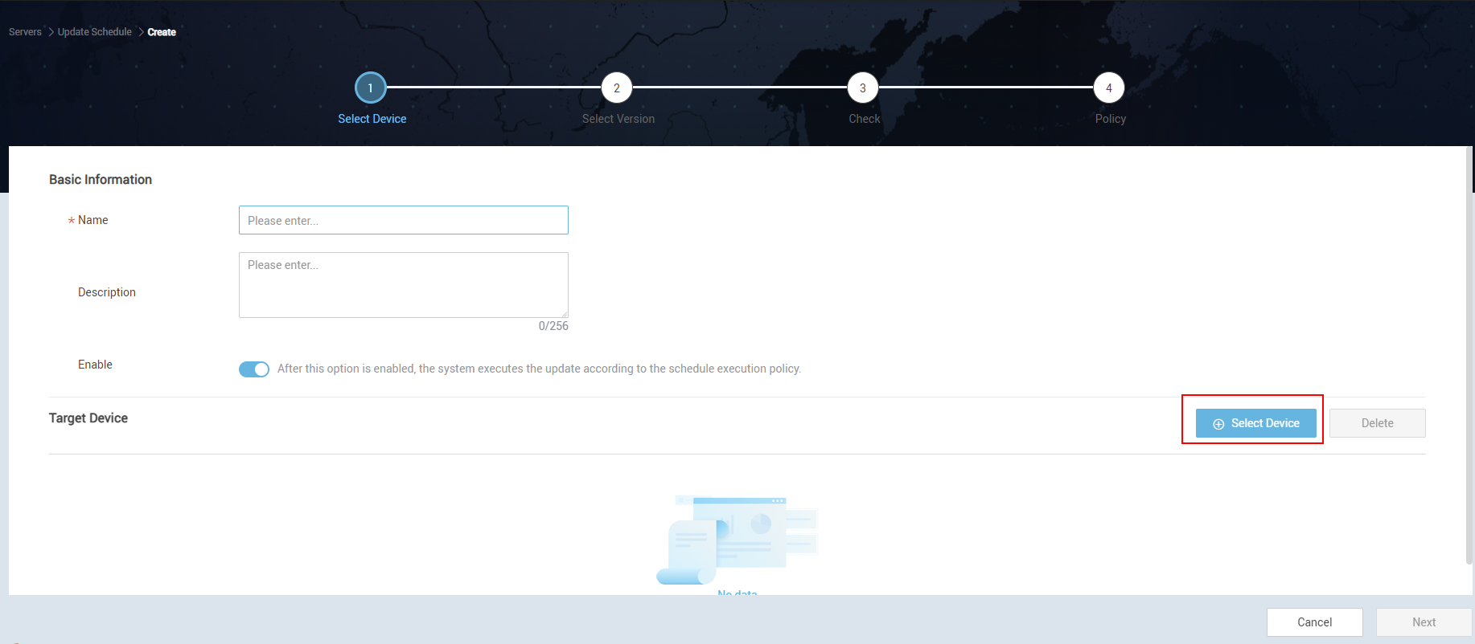
Creating an Upgrade Schedule

Slide 11
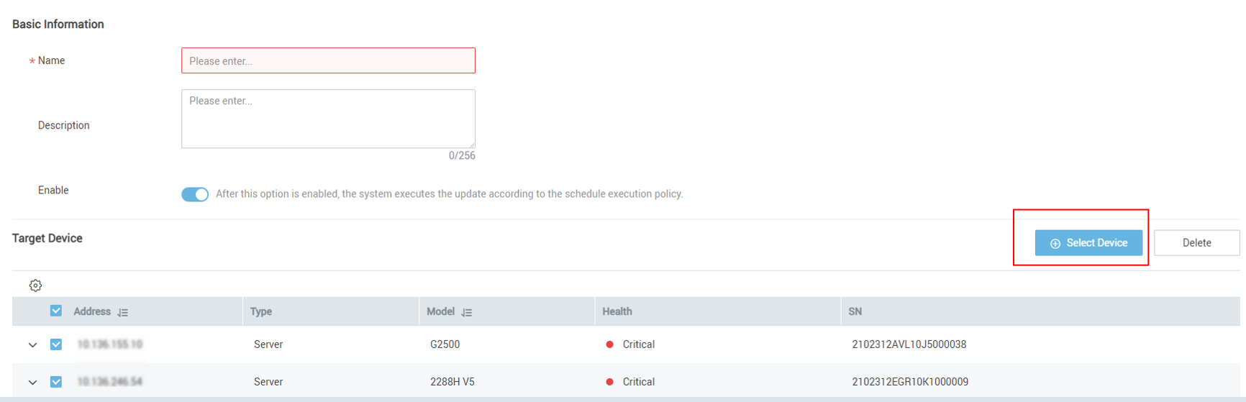
Selecting a Device

Slide 12
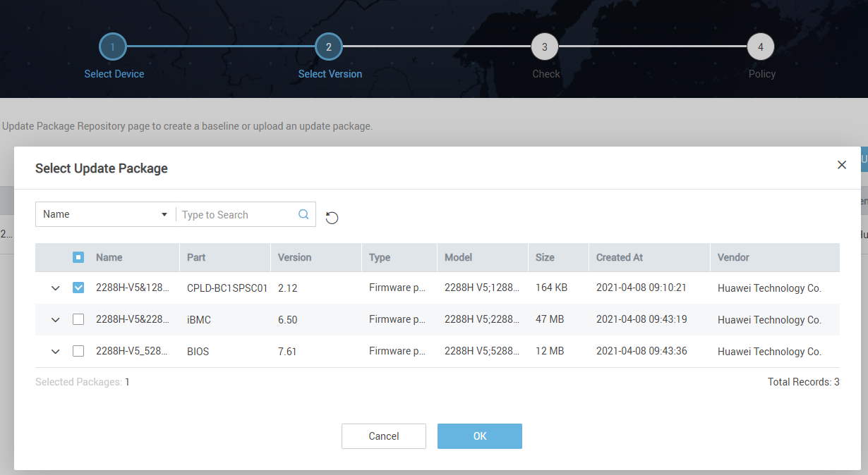
Selecting an Upgrade Package

Slide 13
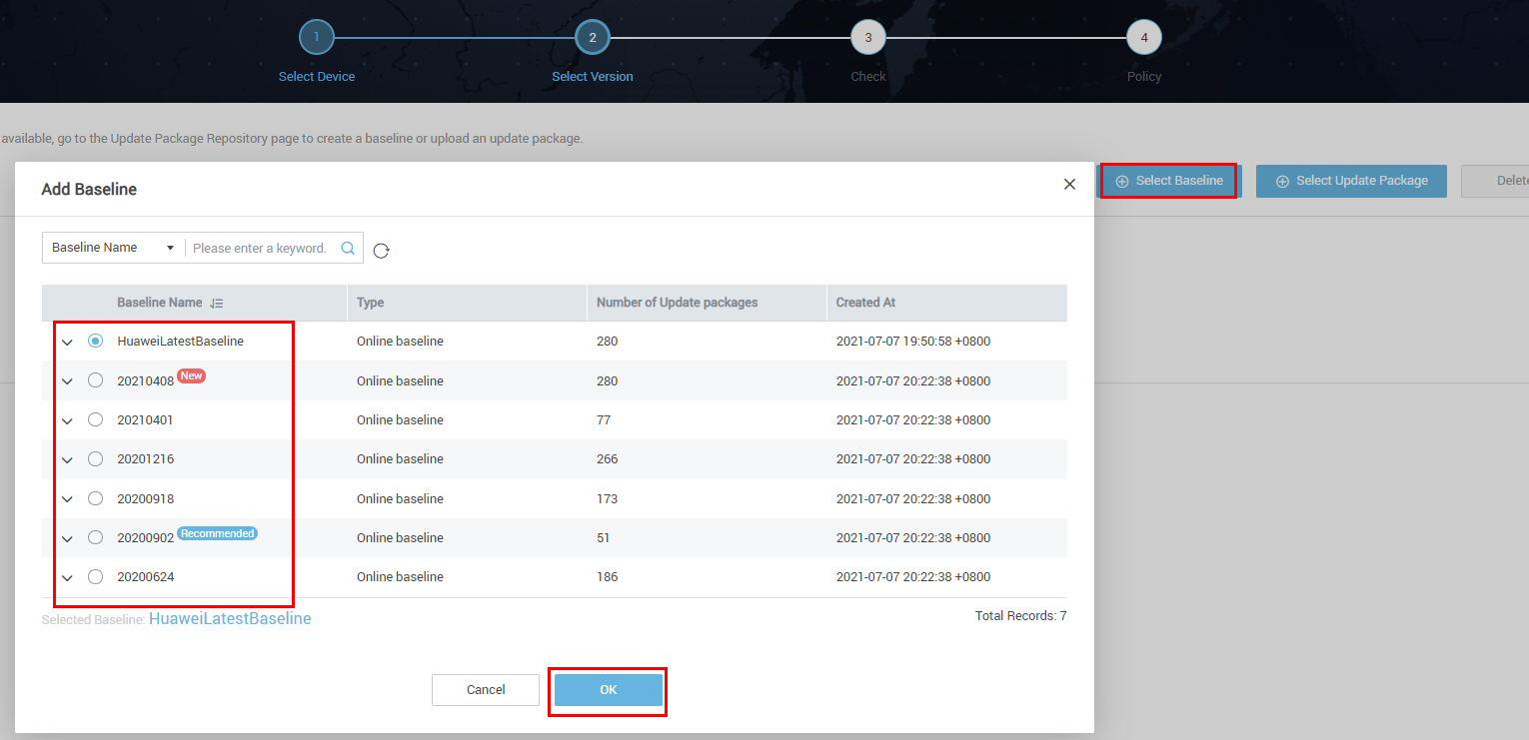
Selecting a Baseline

Slide 14
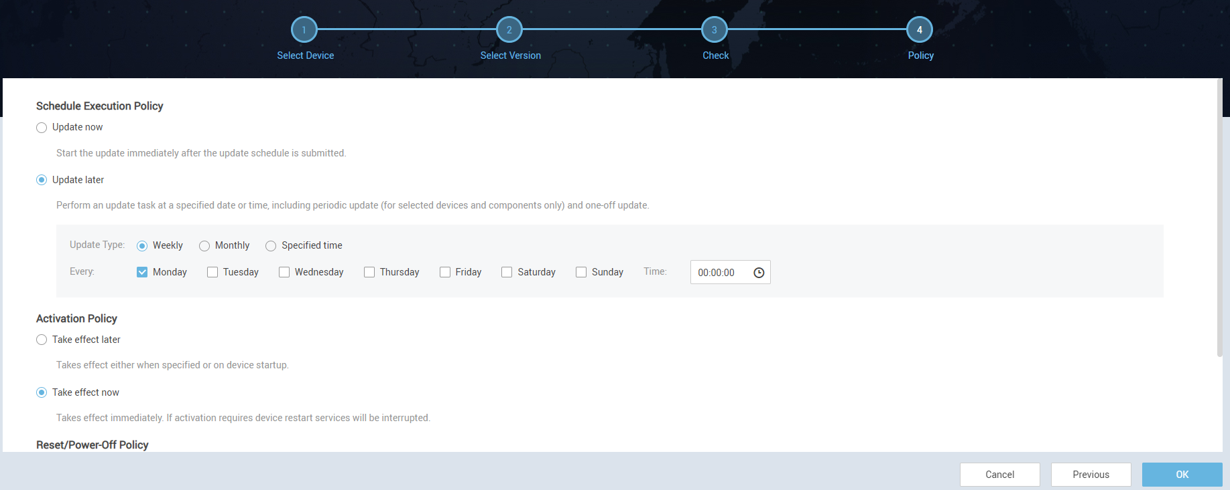
Configuring Policies

Slide 15
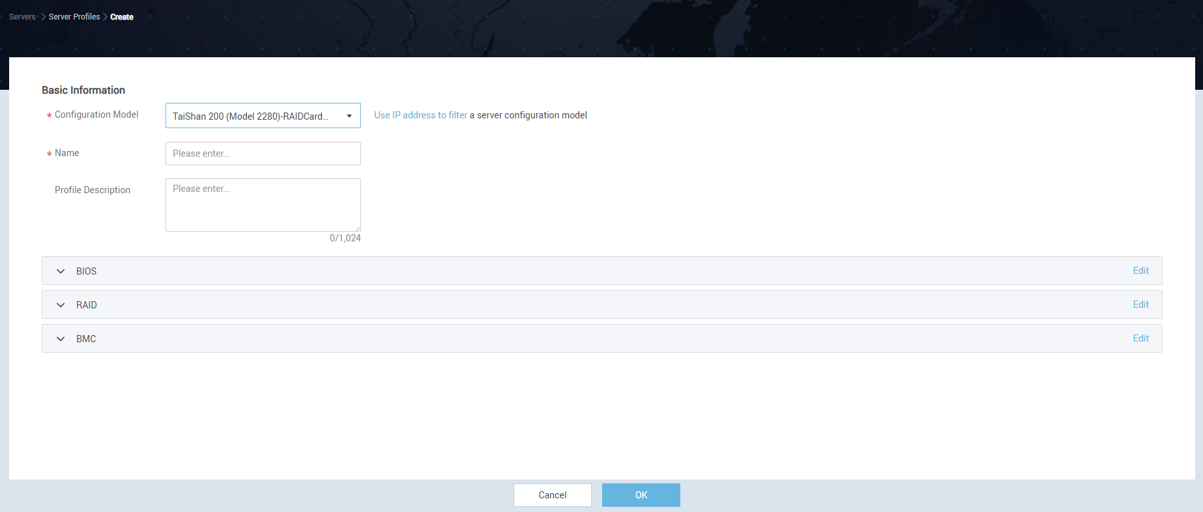
Creating a Profile

Slide 16
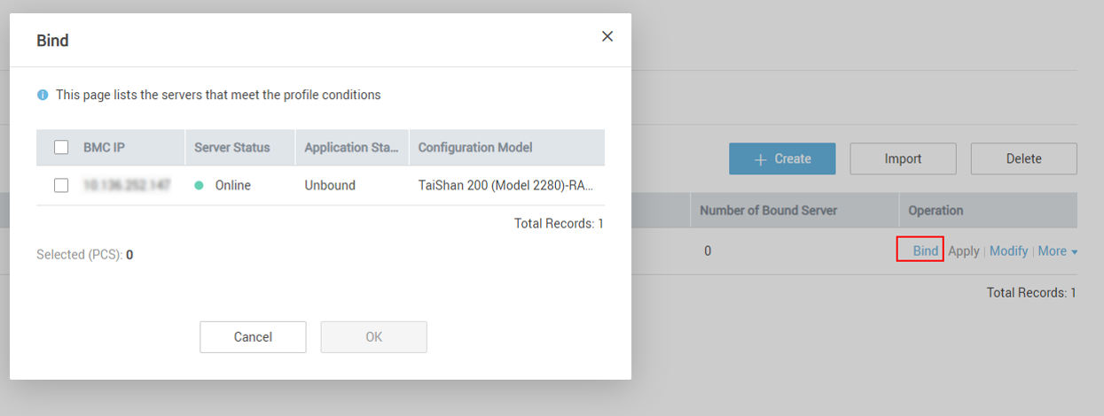
Binding a Server

Slide 17
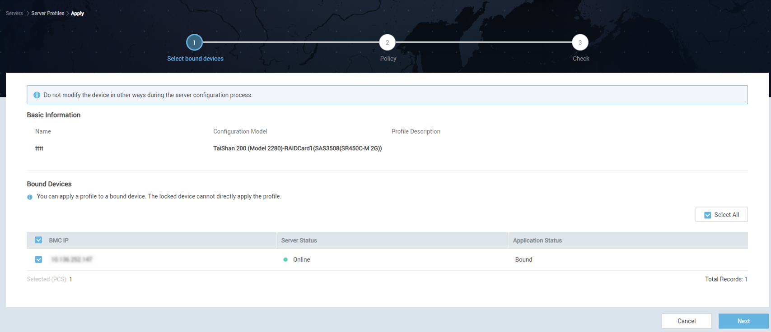
Applying a Profile to a Server

Slide 18
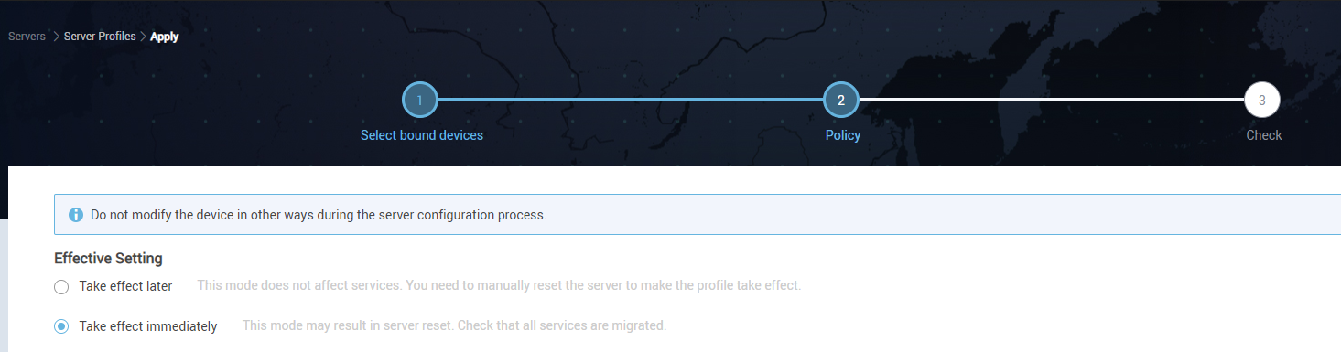
Configuring an Effective Policy

